Slide 1
THE BUSINESS ANALYST
Basic Course 101

Slide 2
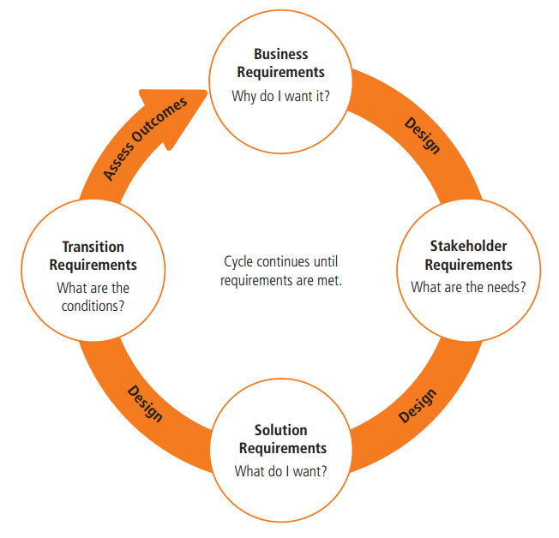
What does
Business Analyst do?

Slide 3
Common knowledge areas
Business Analysis Planning and Monitoring
Strategy Analysis
Requirements Analysis and Design Definition
Elicitation and Collaboration
Requirement Life Cycle Management
Solution Evaluation

Slide 4

Common knowledge areas
Business Analysis Planning and Monitoring
Business Analysis Planning and Monitoring
describes the tasks used to organize and coordinate business analysis efforts.
Back
To Plan

Slide 5

Common knowledge areas
Strategy Analysis
describes the tasks used to identify the business need, address that need, and align the change strategy within the enterprise.
Strategy Analysis
Back
To Plan

Slide 6

Common knowledge areas
Requirements Analysis and Design Definition
describes the tasks used to organize requirements, specify and model requirements and designs, validate and verify information, identify solution options, and estimate the potential value that could be realized.
Requirements Analysis and Design Definition
Back
To Plan

Slide 7
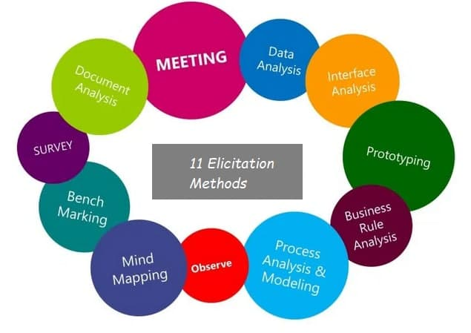
Common knowledge areas
Elicitation and Collaboration
describes the tasks used to prepare for and conduct elicitation activities and confirm the results.
Elicitation and Collaboration
Back
To Plan

Slide 8

Common knowledge areas
Solution Evaluation
describes the tasks used to assess the performance of and value delivered by a solution and to recommend improvements on increasing values.
Solution Evaluation
Back
To Plan

Slide 9
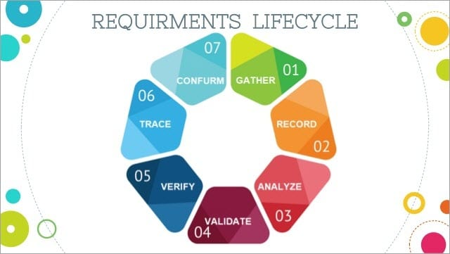
Common knowledge areas
Requirement Life Cycle Management
the tasks used to manage and maintain requirements and design information from inception to retirement.
Requirement Life Cycle Management
Back
To Plan

Slide 10
Personal project plan
Purpose
“In preparing for battle have always found that plans are useless, but planning is indispensable.”
Dwight D.Eisenhower

Slide 11
Personal project plan
When do we need to create or adjust a personal project plan?
Anytime.

Slide 12
Personal project plan
How to create a personal project plan?
Use SMART.

Slide 13
Personal project plan
How to create a personal project plan?
Specific
Measurable
Achievable
Relevant
Time-bound

Slide 14
Personal project plan
Specific (simple, sensible, significant)
Your goal should be clear and specific, otherwise you won't be able to focus your efforts or feel truly motivated to achieve it.
For example:
Bad: I want to be a good BA.
Good: I'm going to focus on boosting my overall BA skills by joining training course.

Slide 15
Personal project plan
Specific (simple, sensible, significant)
When drafting your goal, try to answer the 5 "W" questions:
What will be done?
Why will it be done?
Where will it be done?
When will it be done?
By whom will it be done?
-> action, steps, description
-> justification, reason
-> location
-> time, dates, deadlines
-> responsibility for action

Slide 16
Personal project plan
Measurable (meaningful, motivating)
This can be as simple as setting a specific date for your achievement.
For example:
Bad: I’m going to join BA training course.
Good: I’m going to join knowledge sharing sessions once per week and keep practice what I’ve learnt in Q2 2021.

Slide 17
Personal project plan
Achievable (agreed, attainable)
This should be realistic, challenged, but not cause stress or injury.
For example:
Bad: I’m going to be expert in creating all kinds of diagrams in one week.
Good: I’m going to be guide about one by one diagram and practice it in one week to understand deeply.

Slide 18
Personal project plan
Relevant (reasonable, realistic and resourced, results-based)
To align with the enterprise’s vision, mission, and goals.

Slide 19
Personal project plan
Time bound (time-based, time limited, time/cost limited, timely, time-sensitive)
This can be as simple as setting a specific date for your achievement.
For example:
Bad: I’m going to join BA training course.
Good: “I’m going to join knowledge sharing sessions once per week and keep practice what I’ve learnt in Q2 2021.”

Slide 20
Personal project plan
Some comments:
Tasks name should not be too general
The name of the task should comply with the specified syntax (verb + noun)
Break down big task into small ones (2h ~4h per task)
When setting up plan, divide/combine tasks so that every tasks should be completed within each day. Don't let it extend from day to day.
Training-Plan should have a good hierarchy → need main task with its sub-tasks

Slide 21

Personal project plan
Self-study: Create your plan for the training course.

Slide 22
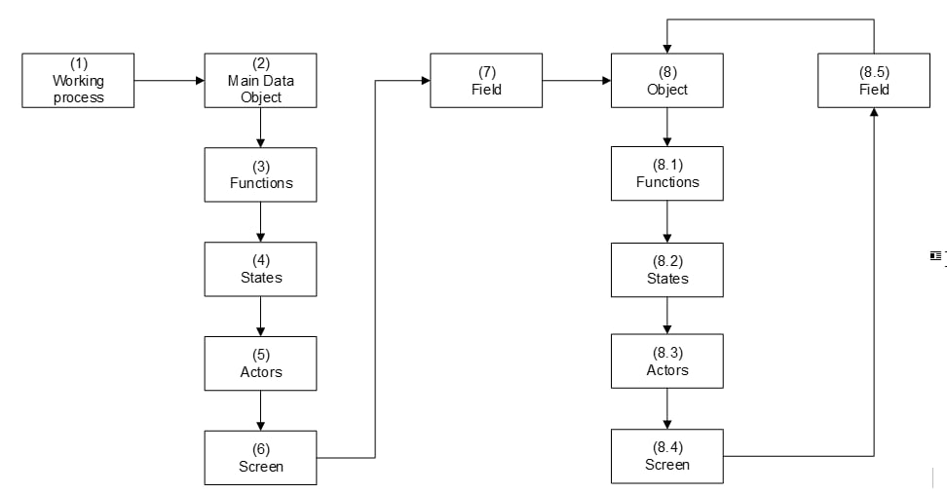
Define business process

Slide 23

Thank you for listening!

